Slide 1

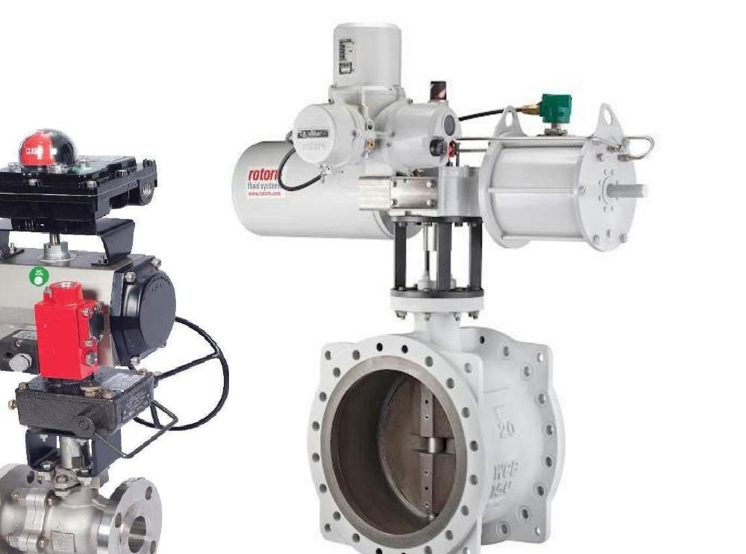
Engineering Flow, Empowering Industries
Your Trusted Partner in Customised Valves, Automation & System Integration
EST. 1967 • 56+ YEARS OF LEGACY
COMPANY PROFILE

Slide 2
Company Overview
A Trusted Name in Industrial Valve Automation & System Integration
Automax Engineers Private Limited is a multi-diversified manufacturer and system integrator with a rich legacy that began in 1967.
1967
56+
We have evolved into a comprehensive solution provider for critical flow applications, blending innovation, engineering precision and deep industry experience across India.
ESTABLISHED
YEARS OF LEGACY
WE SPECIALISE IN
Pan-India
100+
Critical Cryogenic & High-Pressure Pneumatic Supercritical Cylinders
(under the Automax-AEC brand)
Ferrule Fittings, Volume Tanks, Manifolds, AFRs
Fabricated Butterfly Valves, Knife Gate Valves & Other Engineered Products
SERVICE REACH
MARQUEE CLIENTS
INDUSTRIES SERVED
Oil & Gas • Power • Steel & Metals • Cement • Chemicals • Pharma • Food & Beverages • Defence & Railways • Water & Wastewater
Automax Engineers Pvt. Ltd. | Engineering Flow, Empowering Industries
2 / 16

Slide 3
Vision & Mission
Engineering precision flow-control solutions for industrial India
VISION
MISSION
To be India's most trusted partner for customised valves, automation and system integration — recognised globally for engineering excellence, reliability and the long-term success of every customer we serve.
Build on our 1967 legacy as a pipeline solution and special valve manufacturer — a journey that began in collaboration with industry giants like BHEL (Valves Division).
Deliver engineered, reliable and cost-effective flow-control solutions that meet the most demanding standards of India's process industries.
Maintain industry leadership through stringent quality controls, multi-location pan-India presence, and partnerships with globally recognised certification bodies.
Automax Engineers Pvt. Ltd. | Engineering Flow, Empowering Industries
3 / 16

Slide 4
Why Choose Us
A partner you can build on
01
02
03
5+ Decades of Legacy
Engineering-Focused
Stringent QC Process
Since 1967, an unbroken track record across India's most demanding process industries.
Tailor-made automation packages designed against site specifications by experienced engineers.
Stage-wise inspection, MTC 3.1, IBR, third-party inspection, FAT, SAT and customer approvals.
04
05
06
Pan-India Service Reach
SIL-3 Capable Solutions
Strategic OEM Alliances
Regional offices in 4 major cities with on-site installation, AMC and service contracts.
HIPPS & ESDV systems engineered with full redundancy on final control elements & solenoids.
Authorised partner of BDK, L&T, Flowserve, KSB, KSB MIL Controls, ASCO-Emerson, Rotex & more.
Automax Engineers Pvt. Ltd. | Engineering Flow, Empowering Industries
4 / 16

Slide 5
Our Product Portfolio
Four core solution categories — engineered end-to-end
01
Industrial Valves (Manual)
Ball • Butterfly • Plug • Gate • Globe • Check • Knife Gate
02
Customised Valves & Solutions
Deadman • Spring Return • Extended Stem • Jacketed • Iris • Lined • Fabricated • Non-Metallic • Hygienic • Pinch
03
Valve Automation Systems
MOV • ROV • ON-OFF / ROSOV • E/H Actuated • Control Valves • Damper Automation • HIPPS / ESDV (SIL-3 Capable)
04
Automation Components & Accessories
Solenoid Valves • Limit Switches • Pneumatic Cylinders • AFR / FRL • Volume Boosters • QEV • Tubes & Fittings • Junction Boxes • Control Panels
Automax Engineers Pvt. Ltd. | Engineering Flow, Empowering Industries
5 / 16

Slide 6
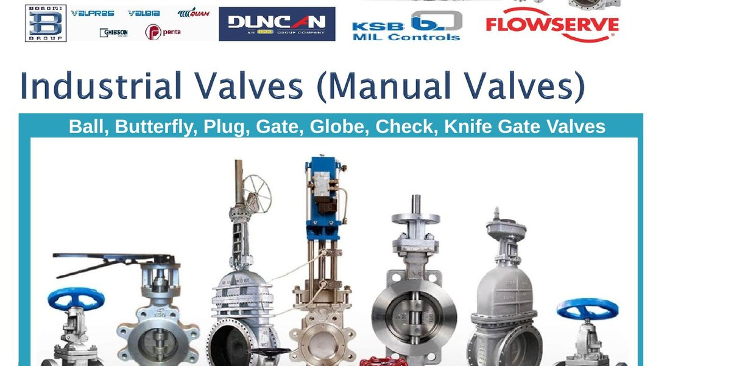
Industrial Valves (Manual)
Complete range of manual valves for process applications
Ball Valves
Floating & trunnion-mounted for tight shut-off.
Butterfly Valves
Concentric & double/triple offset for large bores.
Plug Valves
Lubricated, sleeved & lined for severe service.
Gate Valves
Wedge, parallel slide & through-conduit.
Globe Valves
Stop, stop-check & angle valves.
Check Valves
Swing, lift, dual-plate & tilting-disc NRVs.
Knife Gate Valves
Standard & bonneted for slurry & abrasive media.
Automax Engineers Pvt. Ltd. | Engineering Flow, Empowering Industries
6 / 16

Slide 7
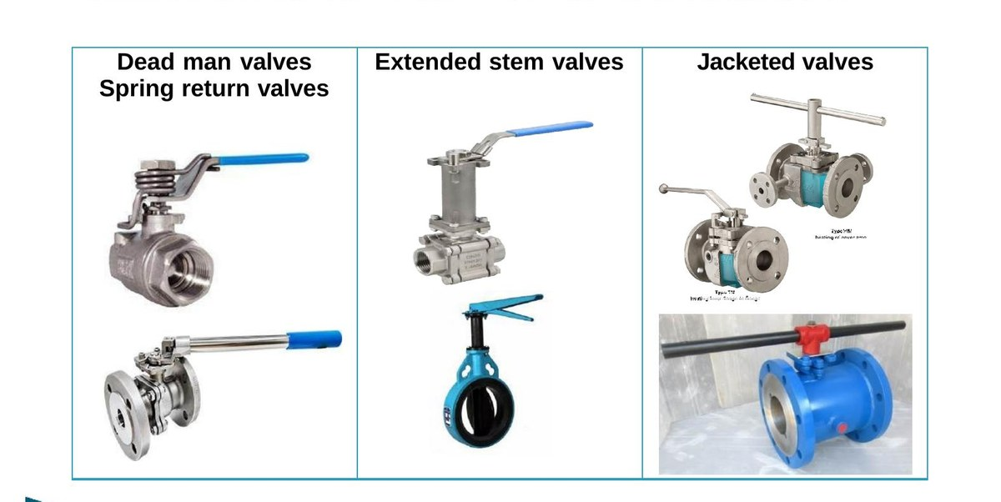
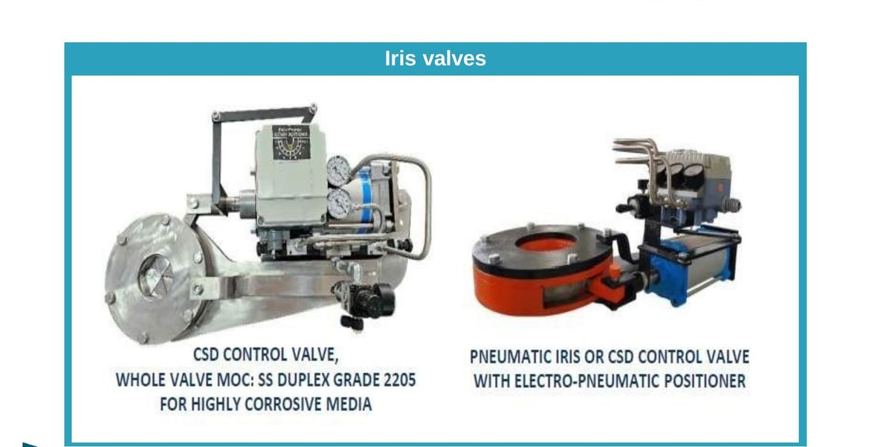
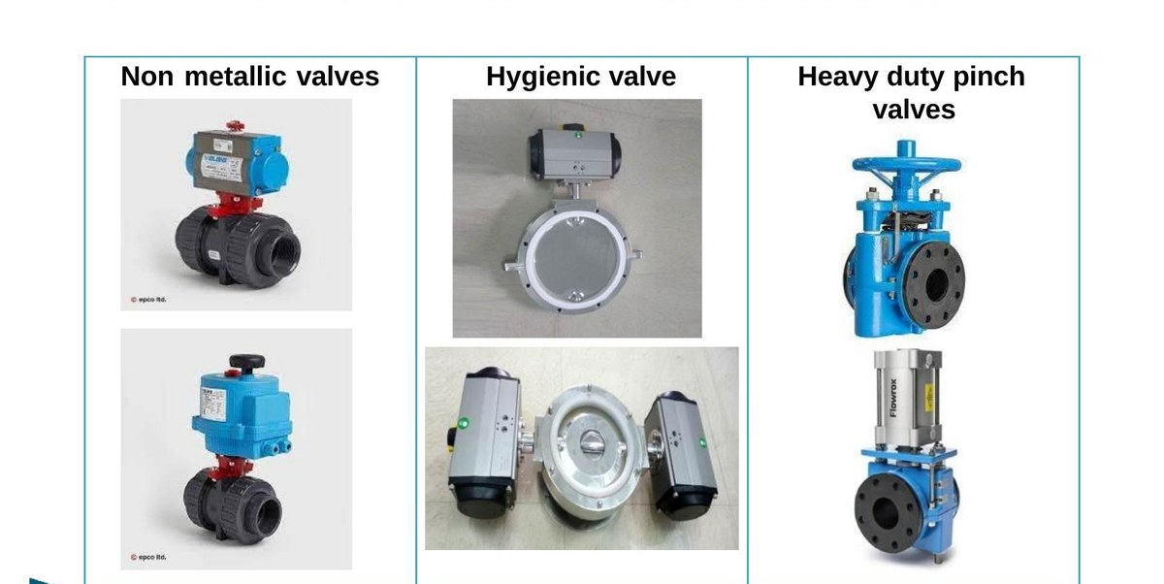
Customised Valves & Solutions
Specialised valves engineered to spec for severe service
Deadman Valves Fail-safe operation — close on operator release.
Lined Valves PFA, PTFE & rubber-lined for aggressive chemicals.
Spring Return Mechanical fail-safe for emergency closure / opening.
Fabricated Valves Custom-fabricated butterfly, knife gate & special valves.
Extended Stem Cryogenic & underground service applications.
Non-Metallic Valves PP, PVDF & FRP for highly corrosive applications.
Jacketed Valves Steam / thermal-fluid jacketed for viscous media.
Hygienic Valves Tri-clamp & sanitary for pharma & food & beverage.
Iris Valves CSD control & pneumatic iris with positioner for corrosive media.
Heavy Duty Pinch Full-bore pinch valves for slurries & abrasive solids.
Automax Engineers Pvt. Ltd. | Engineering Flow, Empowering Industries
7 / 16

Slide 8
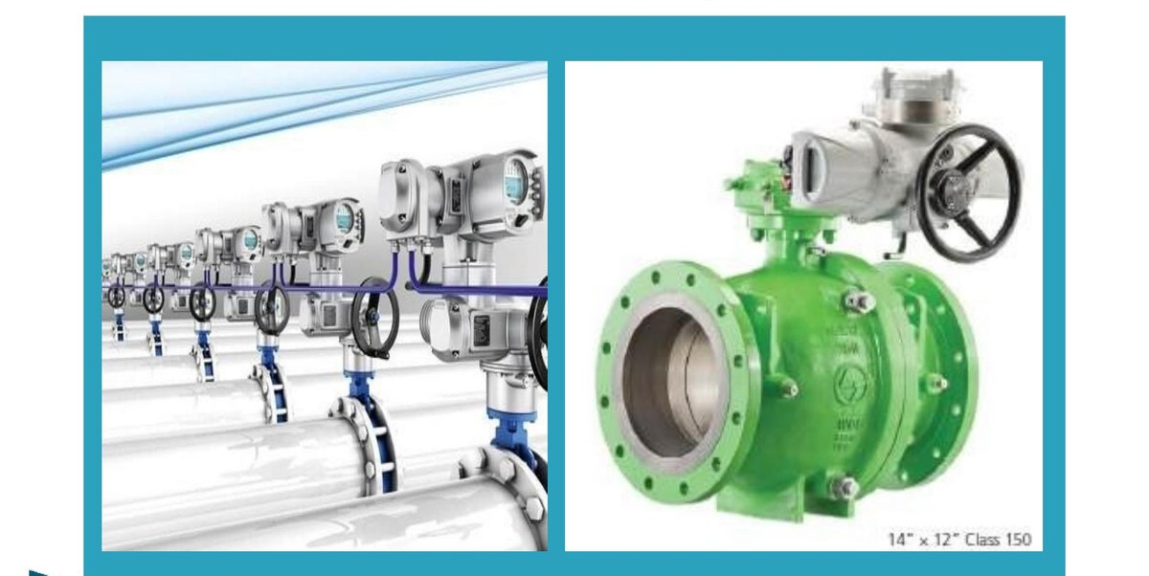
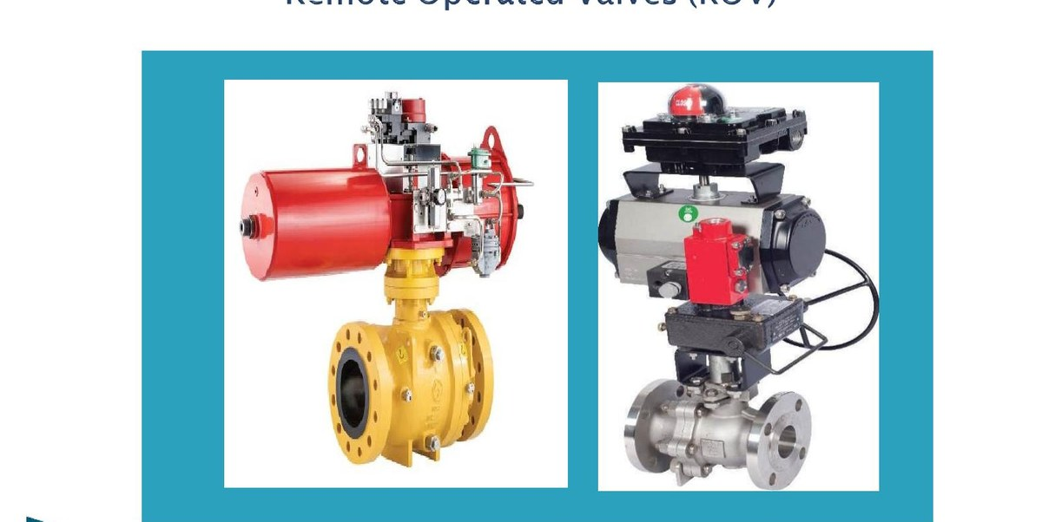
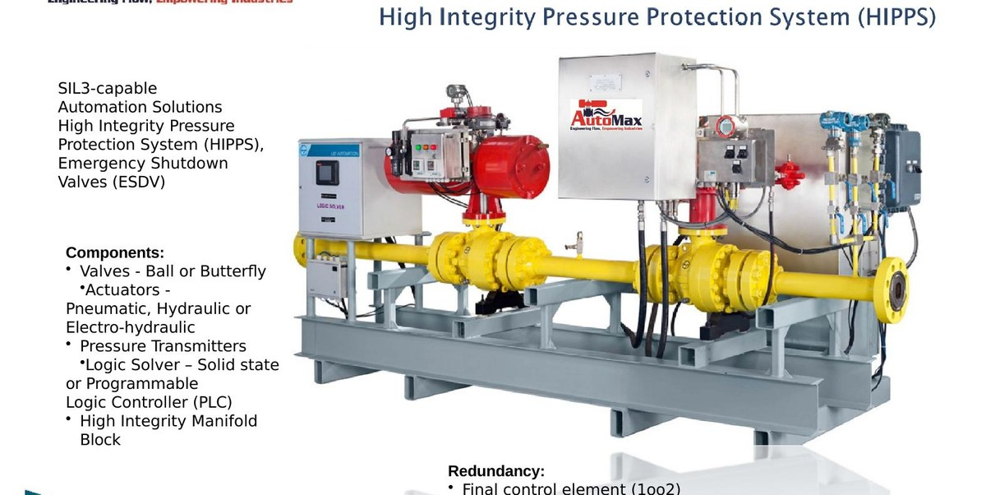
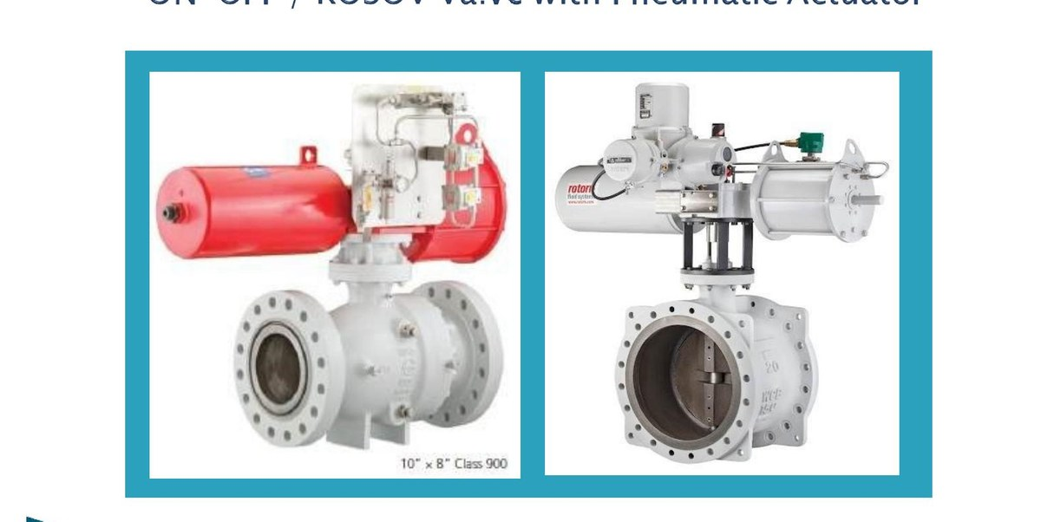
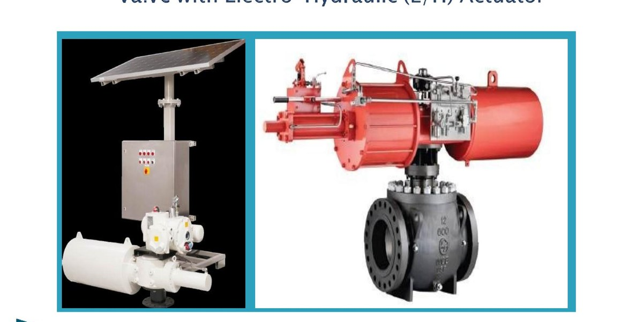
Valve Automation Systems
From sizing & selection through assembly, integration & commissioning
SIL-3 CAPABLE
HIPPS & ESDV Systems
Motor Operated Valves (MOV)
Remote Operated Valves (ROV)
High Integrity Pressure Protection Systems (HIPPS) and Emergency Shutdown Valves (ESDV) engineered with full redundancy on final control elements, solenoids, transmitters, and Logic Solver/PLC.
ON-OFF / ROSOV with Pneumatic Actuator
Electro-Hydraulic (E/H) Actuated
Automax Engineers Pvt. Ltd. | Engineering Flow, Empowering Industries
8 / 16

Slide 9
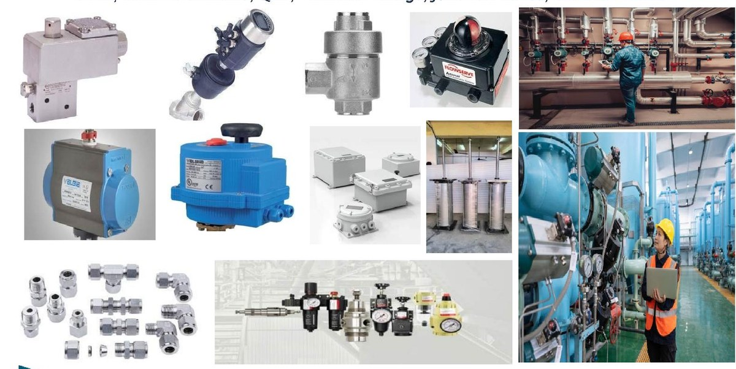
Automation Components & Accessories
The complete ecosystem for valve automation packages
Solenoid Valves
Limit Switches
Pneumatic Actuators
Pneumatic Cylinders
AFR / FRL Units
Volume Boosters
Quick Exhaust Valves (QEV)
Tubes & Fittings
Junction Boxes
Control Panels
Position Transmitters
Smart Positioners
All accessories sourced from approved OEM partners — including SIL-rated, explosion-proof and IP65/IP67-certified variants for hazardous-area applications.
Automax Engineers Pvt. Ltd. | Engineering Flow, Empowering Industries
9 / 16

Slide 10
Specialised Services
Beyond products — end-to-end engineering support
01
Greenfield Project Consulting, Design & Execution
02
Complete System Integration
Complete consulting and execution of greenfield project automation scope.
From initial design to final commissioning — single-source ownership of integration.
03
Valve Automation Training & Maintenance Support
04
Skid Design, Installation & Annual Maintenance Contracts (AMC)
Customer training programmes and on-going technical support.
Skid design, installation supervision and structured AMC contracts.
05
Valve Repair & Re-Certification Services
06
In-House & Outsourced Testing
Workshop-based and on-site valve repair, refurbishment and re-certification.
Hydrostatic, pneumatic, functional, high-pressure nitrogen, PMI, NDT, ultrasonic & radiographic testing.
Automax Engineers Pvt. Ltd. | Engineering Flow, Empowering Industries
10 / 16

Slide 11
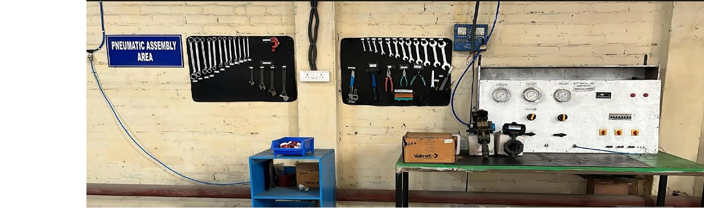
Testing & Quality Assurance
Stringent QC across every stage of assembly and integration
IN-HOUSE TESTING
OUTSOURCED TESTING
Hydrostatic Testing (up to 8" Valve)
Pneumatic Testing
Functional Testing for Complete Valve Automation
High-Pressure Nitrogen Testing (small sizes up to 3")
Calibration Facility
PMI Testing
NDT (Non-Destructive Testing)
Ultrasonic Testing
Magnetic Particle & Liquid Penetrant Testing
Radiographic Testing
High-Pressure Nitrogen Testing (above 3" Valve)
Automax Engineers Pvt. Ltd. | Engineering Flow, Empowering Industries
11 / 16

Slide 12
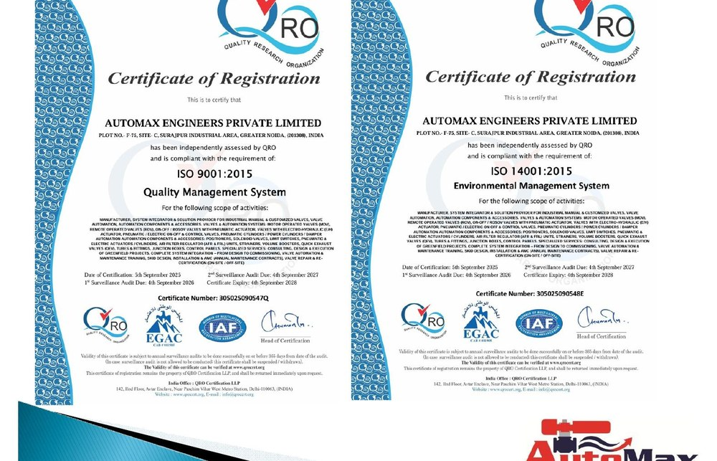
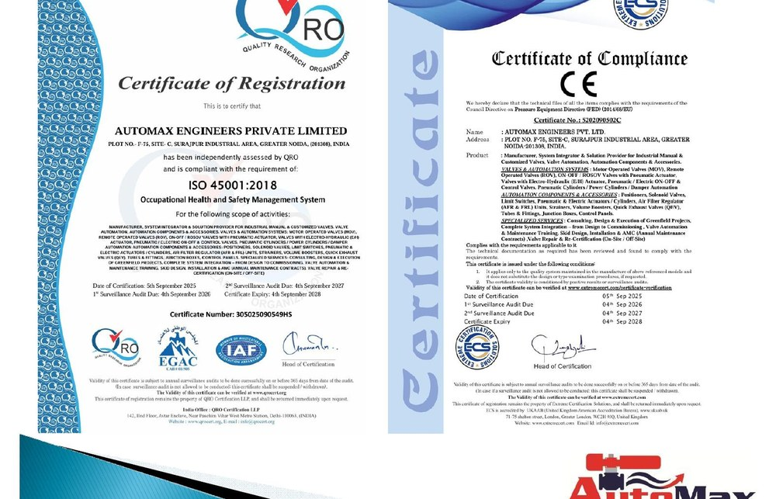
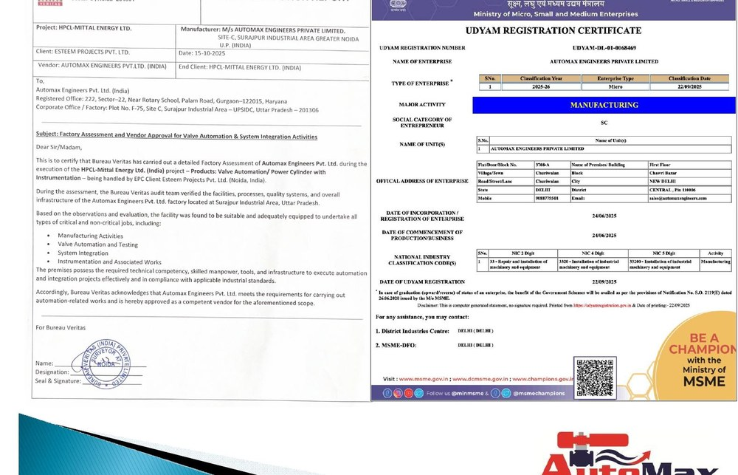
Certifications & Approvals
Quality backed by globally recognised bodies
ISO 9001:2015
ISO 14001:2015
ISO 45001:2018
Bureau Veritas
Quality Management
Environmental Management
Health & Safety
Oil & Gas Approved
PROUDLY CERTIFIED & APPROVED BY GLOBALLY RECOGNISED BODIES
IAF
EGAC
UKAAB
Bureau Veritas
International Accreditation Forum
Egyptian Accreditation Council
UK American Accreditation Bureau
(India) Private Limited
Automax Engineers Pvt. Ltd. | Engineering Flow, Empowering Industries
12 / 16

Slide 13
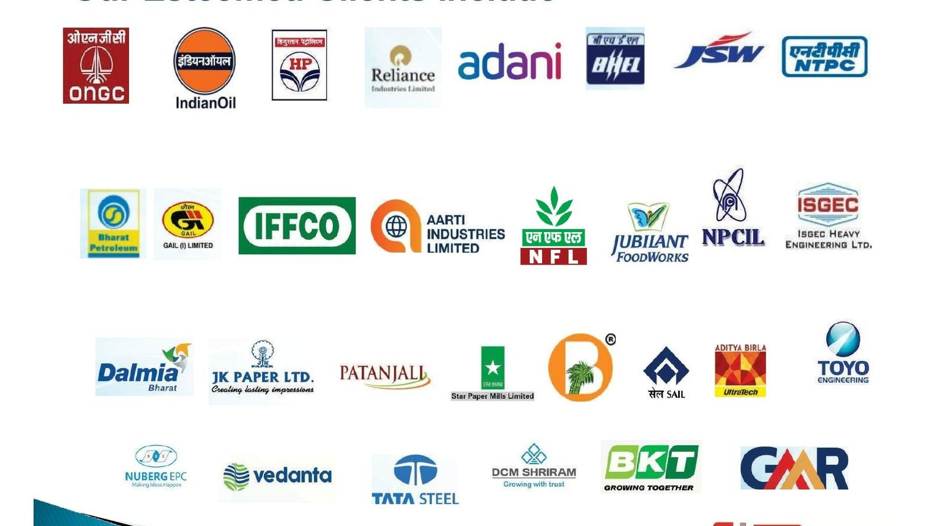
Our Esteemed Clients
Trusted by India's industrial leaders across sectors
Oil & Gas • Power • Steel • Cement • Pharma • Chemicals • Fertilizers • Defence • Food & Beverages
Automax Engineers Pvt. Ltd. | Engineering Flow, Empowering Industries
13 / 16

Slide 14
Strategic OEM Alliances & Channel Partners
Authorised partner of leading global valve & actuator manufacturers
BDK Valves
L&T Valves
Flowserve
KSB Valves
KSB MIL Controls
GM Valves
Bonomi Group
Valpres
Rubinetterie Bresciane-India
Ghibson Italia
Penta S.r.l.
DIVYA Control
Fluid Controls Limited
Rotex
ASCO — Emerson IN
As an authorised partner, we deliver genuine OEM products with full warranty, technical support, and engineering expertise across India.
Automax Engineers Pvt. Ltd. | Engineering Flow, Empowering Industries
14 / 16

Slide 15
Infrastructure & Facilities
Pan-India presence with two manufacturing & integration units
CORPORATE OFFICE
REGISTERED OFFICE
REGIONAL OFFICE
Greater Noida
Gurugram
New Delhi
75, Block F, UPSIDC Site C, Surajpur, Greater Noida, UP 201306
222, Sector 22A, Gurugram, Haryana – 122015
Sales & engineering support for Delhi NCR.
REGIONAL OFFICE
REGIONAL OFFICE
REGIONAL OFFICE
Navi Mumbai
Bangalore
Kolkata
Sales & engineering support for Western India.
Sales & engineering support for South India.
Sales & engineering support for Eastern India.
INTEGRATION & MANUFACTURING FACILITIES
Unit 1: New Delhi • Unit 2: UPSIDCA Site C, Greater Noida
Automax Engineers Pvt. Ltd. | Engineering Flow, Empowering Industries
15 / 16

Slide 16
Thank You
Engineering Flow, Empowering Industries
GET IN TOUCH WITH US
PHONE
EMAIL
WEBSITE
+91 9088 775 501
sales@automaxengineers.com
www.automaxengineers.com
Corporate Office: 75, Block F, UPSIDC Site C, Surajpur, Greater Noida, Uttar Pradesh 201306
Registered Office: 222, Sector 22A, Gurugram, Haryana – 122015

